Slide 1


Plana5
Enabling rapid decision making for project staffing.
Notes:
Hey, we're Plana5 and we're reimagining project staffing in consulting firms, enabling rapid and data driven decision making.

Slide 2

Staffing Time per project in hours has become Slower from 2015 - 2024
+64 % rise since 2015
Notes:
In the past 10 years, staffing time per project has risen 64%. From 2.8 hours to 4.6 today. What happened? remote work and increasingly complex approval layers.

Slide 3
Notes:
And those 4.6 hours aren’t just free. Let’s break them down. Partner €240,000 ~ €80/hour Project Lead €145,000 ~ €48/hour Consultant €80,000 ~ €27/hour

Slide 4

233 €
Partner
Notes:
At partner level, the time spent on project management is worth around €233 in salary. Around 20% is spent by the partner RoleBase Salary Range (USD)Average Base Salary (USD) Partner ~$240,000 Project Lead ~$145,000
Consultant ~$80,000

Slide 5
233 €
Partner
222 €
Project Leads
Notes:
Project leads scout for employees, check availability and try to find the right fit... Manually–costing us €222.

Slide 6
233 €
Partner
222 €
Project Leads
37 €
Consultants (3x-4x)
Notes:
The team of consultants sits at just €37. But…

Slide 7

0
1
2
3
4
5
6
7
8
9
0
0
1
2
3
4
5
6
7
8
9
0
0
1
2
3
4
5
6
7
8
9
0
€
Notes:
Altogether this decision matrix costs us around €491, and that’s per project

Slide 8
0
1
2
3
4
5
6
7
8
9
0
0
1
2
3
4
5
6
7
8
9
0
0
1
2
3
4
5
6
7
8
9
0
€
www
Notes:
But, what if we could cut that down to €207? — by doing all the searching, shortlisting, and notifying… in one minute? Saving us 284€.

Slide 9

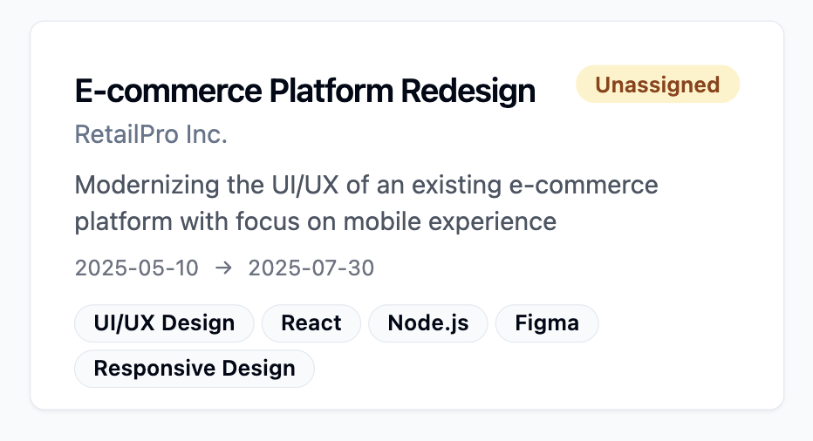
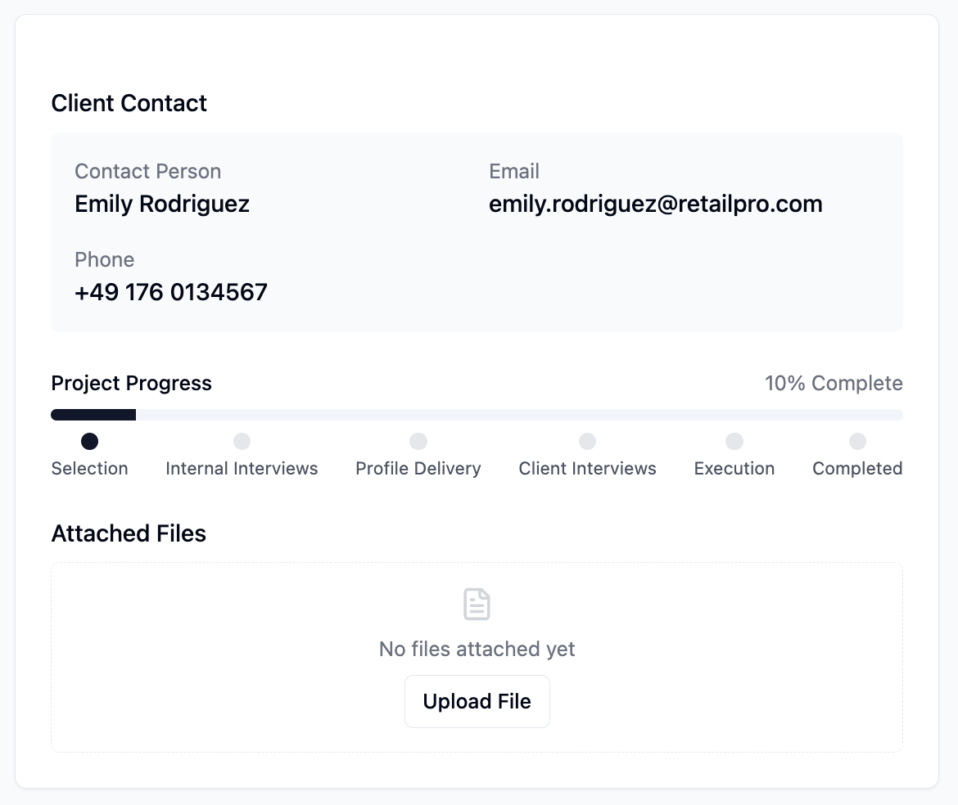
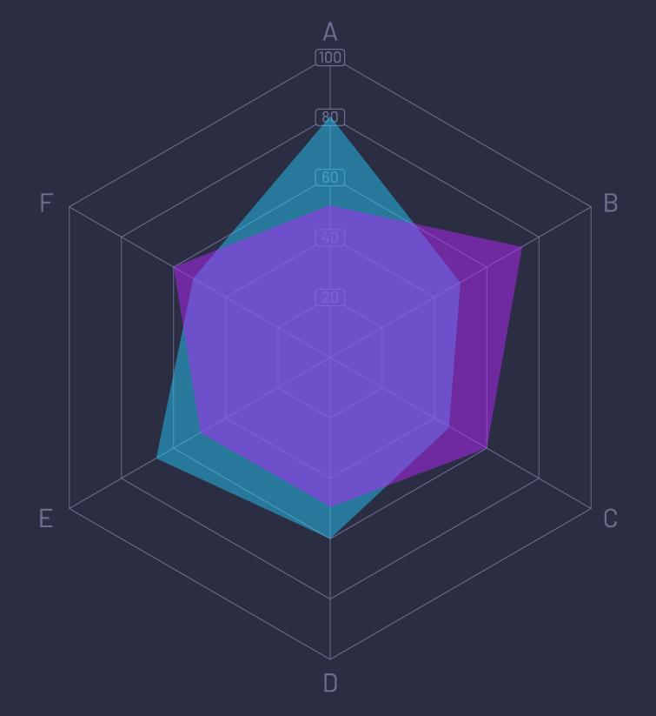

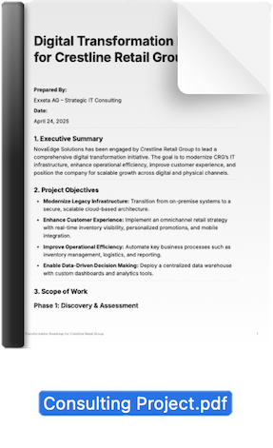
Staff your project…
Hello, Benji.
*proprietary matching algorithm
Finalizing…
Cross-checking profiles…
Matching Agents…
Analyzing data...
Upload a project file to begin. . .
Extracting data...
Notes:
Here’s how that works….(wait) Just upload your project brief — that’s it. Our Plana5 matching algorithm analyzes your needs, checks availability, matches the best people.

Slide 10
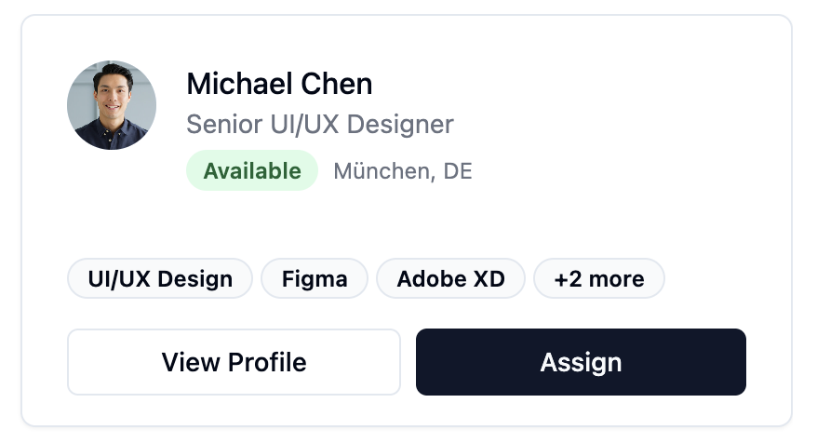
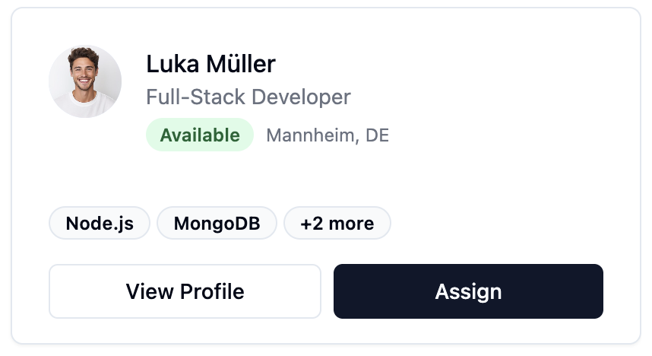
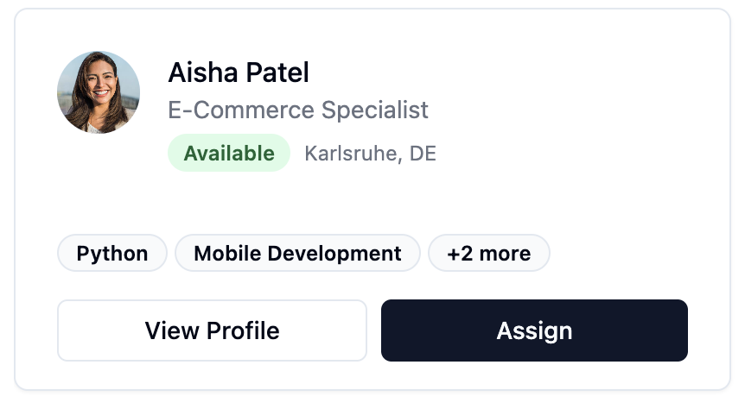
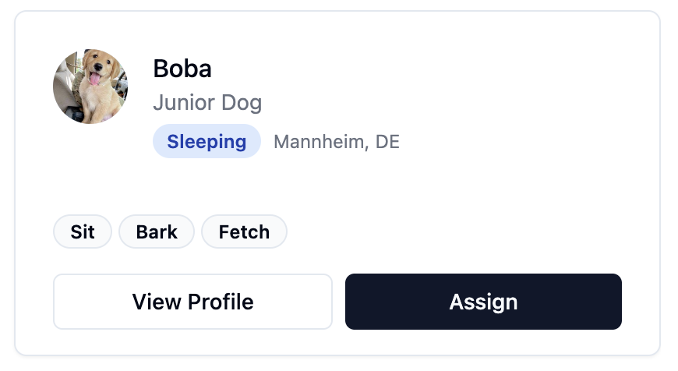
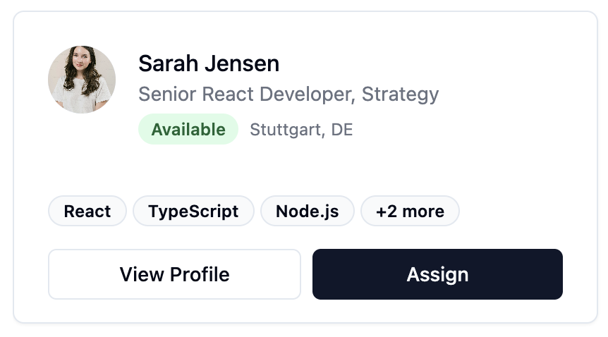

…with the right talent.
Staff your project…
Hello, Benji.
Hello, Benji.
Finalizing…
Cross-checking profiles…
Matching Agents…
Analyzing data...
Upload a project file to begin. . .
Extracting data...
Notes:
In under a minute, we finish staffing your project.

Slide 11
Staff your project…
Hello, Benji.
…with the right talent.
Notes:
And find the best talent available…and

Slide 12


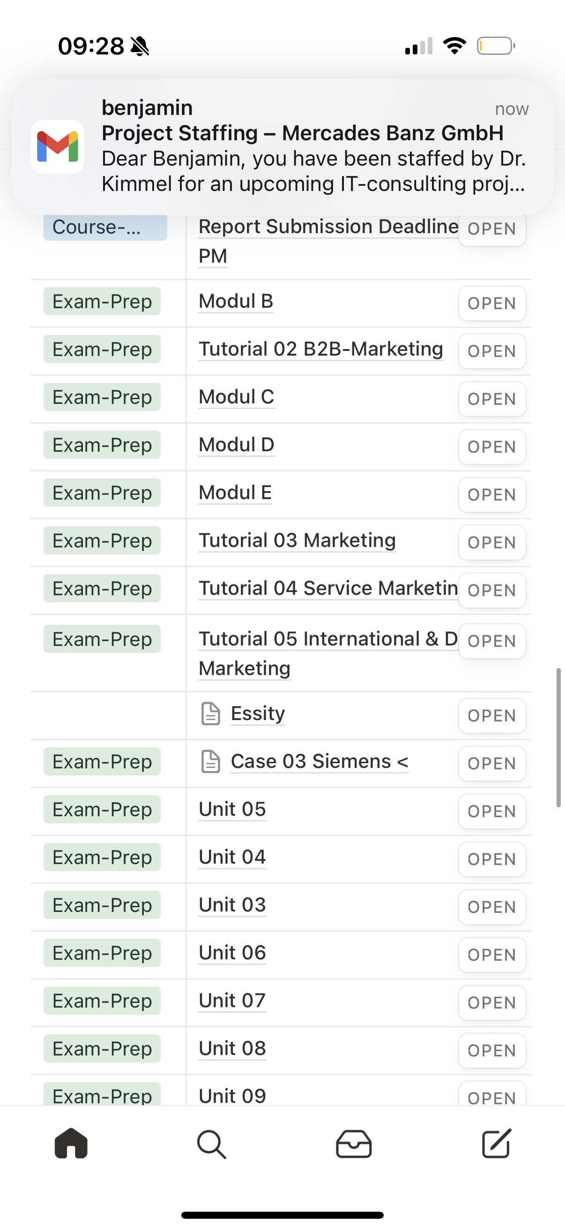

Hello, Benji.
Notify your team.
Notes:
Notify your team by service of your choice. But we don’t just match fast and smart. We provide you with a full HR solution…

Slide 13
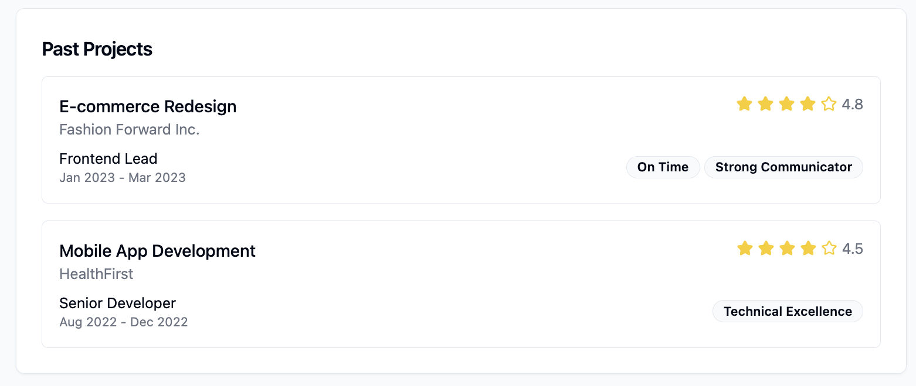
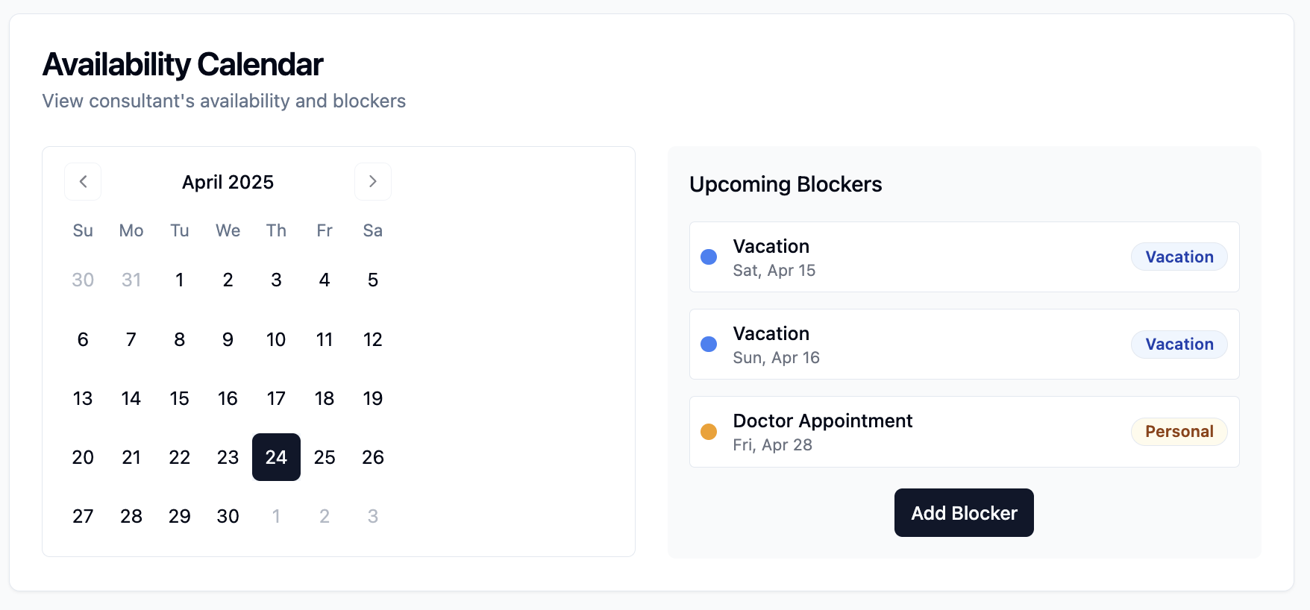
Review Back.
Hello, Benji.
Plan ahead.
Notes:
Allowing you to review back on past projects, plan ahead… generate..

Slide 14
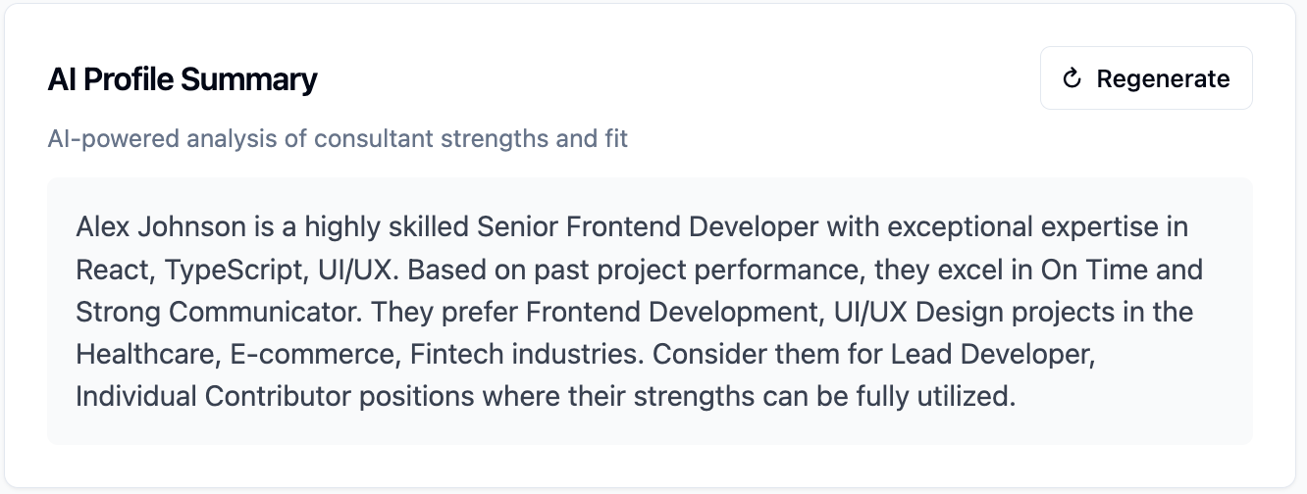
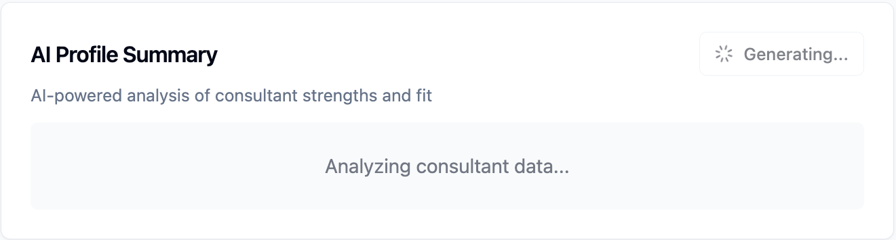
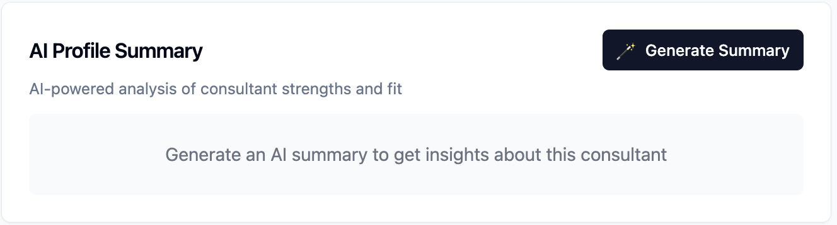
Hello, Benji.
Generate AI summaries.
Notes:
Generate AI summaries.

Slide 15
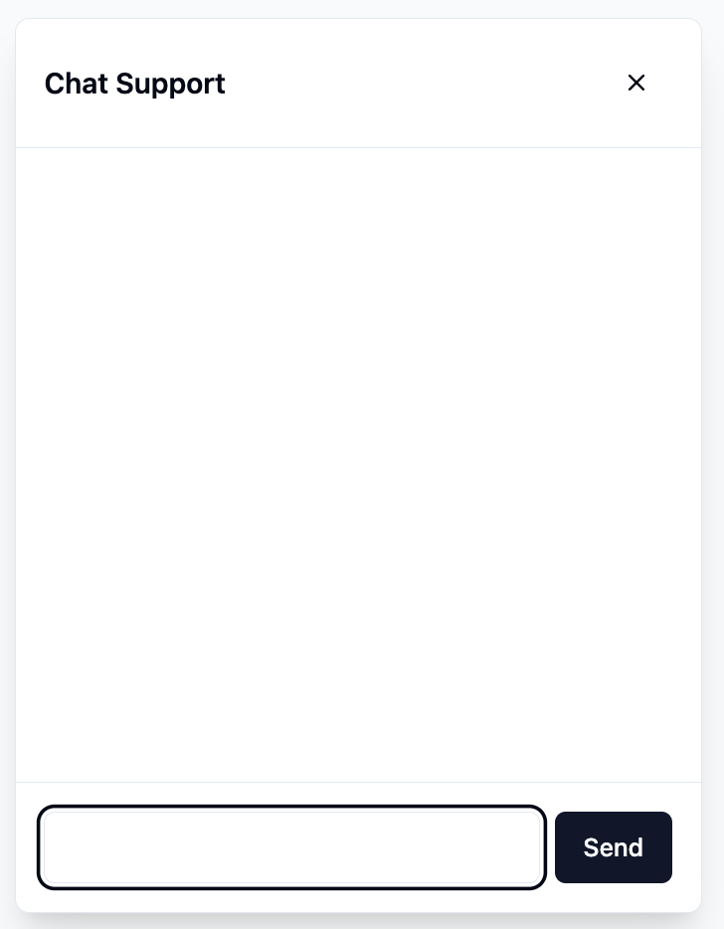


Hello, Benji.
Talk to Plana5 CoPilot.
You personal Assistant.
… you got someone?
Notes:
And, offer you a personal assistant connected to your data system.

Slide 16
Month 01
Hello, Benji.
Let’s raise 20k €.
Help us finish PLANA5 in 2 months and we’ll pilot our product with
10 companies.
Notes:
To finish development we’re looking to raise €20,000 for the next two months, and then pilot test with 10 companies…

Slide 17
End of Month 02
Hello, Benji.
The pilot is sold at 500€.
5k € more in revenue to help us pursue aggressive marketing.
Notes:
At a price of 500€ We plan to use those procees to pursure aggressive market expansion

Slide 18
Month 03 - 04
Hello, Benji.
Unlocking 28,400€ & 260 hours+ at 100 projects a month…
…we can sell our product at a starting price of…
Notes:
Unlocking almost 30,000€ at an average of 100 projects a month and 260 hours saved up, we can offer

Slide 19
Month 03 - 04
Hello, Benji.
Big Enterpise
Medium Enterpise
Small Enterpise
50,000€
15,000€
0€
Unlimited projects.
Unlimited Co-Pilot usage.
Limited to 100 projects a month.
Unlimited Co-Pilot usage.
Limited to 20 projects a month.
Limited Co-Pilot usage.
per Month
per Month
per Month
Your investment needs just…
1 Client to break even
2 Clients to break even.
Notes:
The medium enterprise solution for just 15,000€, and for the many companies that go way beyond, unlimited access and unlimited co pilot usage for just 50,000€.

Slide 20
Month 03 - 04
Big Enterpise
Medium Enterpise
Small Enterpise
0€
50,000€
15,000€
Hello, Benji.
Unlimited projects.
Unlimited Co-Pilot usage.
Limited to 100 projects a month.
Unlimited Co-Pilot usage.
Limited to 20 projects a month.
Limited Co-Pilot usage.
per Month
per Month
per Month
Your investment needs just…
1 Client to break even
2 Clients to break even.
Notes:
If you decide to invest, together, we can break even with just 1 client, or 2 clients maximum.

Slide 21
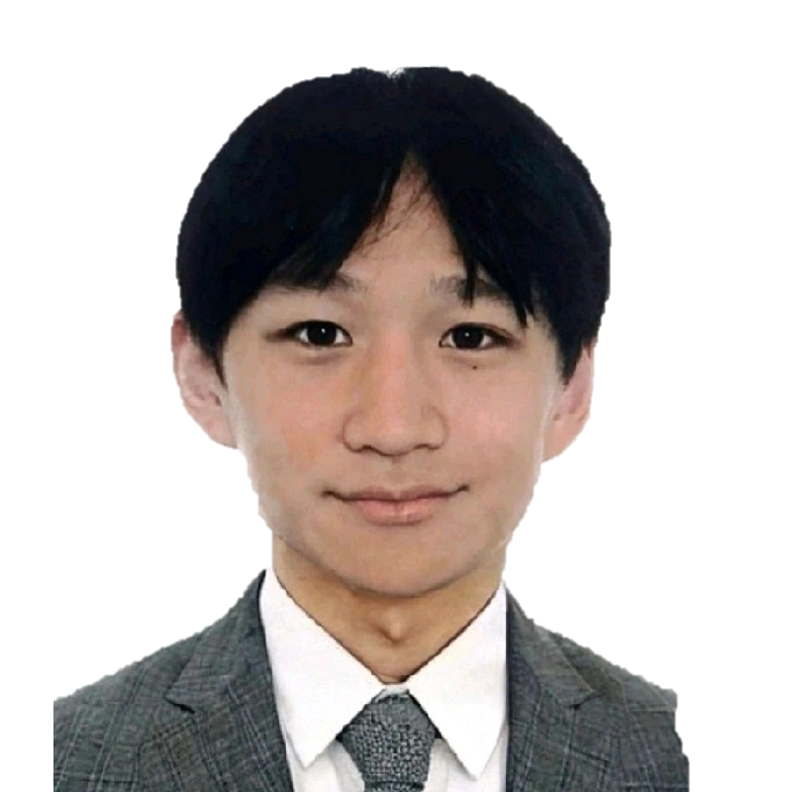




Our Team
Hello, Benji.
Benjamin Chen Strategy & GTM
Sayan Sinha Backend Architecture
Yash Gavade UI/UX
Vismaya BM Operations
Ankita Khedekar Data & Product

Slide 22
Hello, Benji.
Thank you!
We’re ready to build. Let’s talk.
Notes:
Unlocking almost 30,000€ at an average of 100 projects a month and 260 hours saved up, we can offer

Slide 23

Skill Bridge (Demo) by Plana5
Notes:
Hey, I’m Benji — and we’re reimagining how consulting firms staff projects. It’s fast-paced work. But staffing? It’s still slow. Manual, And increasingly painful, we're here to make staffing decision radically faster.

Slide 24
Employee billable utilization at professional services organizations worldwide from 2014 to 2024
Employee billable utilization at professional services organizations 2014-2024
Note(s): Worldwide; 2014 to 2023; 575 respondents; Billable professional services organizations
Further information regarding this statistic can be found on page 8.
Source(s): Service Performance Insight; Kimble; Sage; ID 1012842; 2025 Professional Services Maturity™ Benchmark
1
Notes:
Over the last decade, utilization has become more and more volatile, ever since 2021 we've seen a sharp and steady drop caused by hybrid work and team fragmentation.

Slide 25
Employee billable utilization at professional services organizations worldwide from 2014 to 2024
2014-2024
Note(s): Worldwide; 2014 to 2023; 575 respondents; Billable professional services organizations
Further information regarding this statistic can be found on page 8.
Source(s): Service Performance Insight; Kimble; Sage; ID 1012842; 2025 Professional Services Maturity™ Benchmark
1

